Slide 1
Data Structure and Algorithm
Chapter 3
List
Data Structures

Slide 2
Contents
List ADT
Array implementation of List ADT,
Operations
Time and space complexity of array implementation
Linked list:-
Singly linked lists,
doubly linked lists,
circular (singly and doubly) linked lists,
Operations on linked lists:
creation, insertion, deletion, update, search

Slide 3
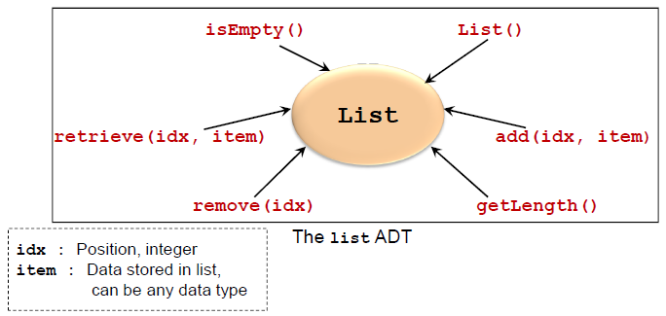
List adt
A list contains elements of same type arranged in sequential order.
Lists are very common in computing
e.g. student list, list of events, list of appointments etc
Two Major Implementations
Array implementation
Linked list implementation

Slide 4
Array Implementation of list adt
Array is a list of a finite number n of homogeneous data elements
The elements of the array are stored respectively in successive memory locations.
Array is a prime candidate for implementing list ADT
Simple construct to handle a collection of items
Operations
addAt(), removeAt(), getSize(), isEmpty()…etc.
Advantage:
Very fast retrieval

Slide 5
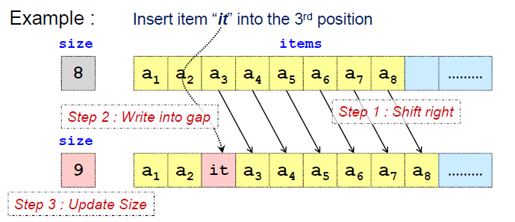
Insertion : Using Array
Simplest Case: Insert to the end of array
Other Insertions:
Some items in the list needs to be shifted
Worst case: Inserting at the head of array

Slide 6
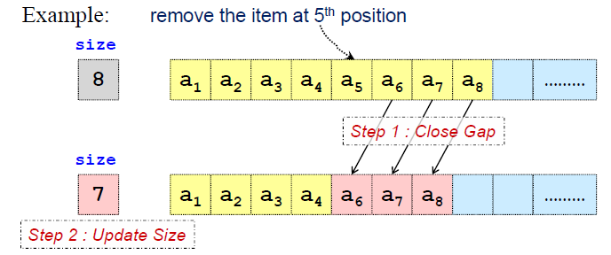
Deletion: Using Array
Simplest Case: Delete item from the end of array
Other deletions:
Items needs to be shifted
Worst Case: Deleting at the head of array

Slide 7
Array Implementation: Efficiency (time)
Retrieval:
Fast: one access
Insertion:
Best case: No shifting of elements
Worst case: Shifting of all N elements.
Deletion:
Best case: No shifting of elements
Worst case: Shifting of all N elements

Slide 8
Array Implementation : Efficiency (space)
Size of array is restricted to MAX_LIST
Problem:
Maximum size is not known in advance
Solution:
Make MAX_LIST a variable
When array is full:
1. Create a larger array
2. Move the elements from the old array to the new array
No more limits on size, but space wastage and copying overhead is still a problem
MAX_LIST is too big == unused space is wasted
MAX_LIST is too small == run out of space easily

Slide 9
Array Implementation : Summary
For fixed-size collections
Arrays are great
For variable-size collections, where dynamic operations such as insert/delete are common
Array is a poor choice of data structure
For such applications, there is a better way……
Limitation of Array
Changing the size of the array requires creating a new array
Inserting/deleting an item requires shifting

Slide 10
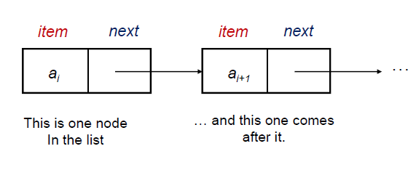
Linked list
A linked list consists of a finite sequence of elements or nodes (not necessarily adjacent in memory) that contain information plus (except possibly the last one) a link to another node.
Unlike an array, however, in which the linear order is determined by the array indices, the order in a linked list is determined by a pointer in each object.
If node x points to node y, then x is called the predecessor of y and y the successor of x.
There is a link to the first element called the head of the list.
Linked lists provide a simple, flexible representation for dynamic sets.
is used quite frequently since it is very efficient.

Slide 11
Cont..
As elements are added to a list, memory for a node is dynamically allocated.
Therefore, the number of elements that may be added to a list is limited only by the amount of memory available.
A linked list can be implemented using
arrays,
dynamic memory management, and pointers.
The second implementation requires dynamic memory management where one can allocate memory at run-time, that is, during the execution of a program.
Linked lists are generally implemented using dynamic memory management.
struct Node {
int data;
Node* next;
};
Node *head = new Node;

Slide 12
singly linked list
A linked list is an ordered collection of data in which each element (node) contains a minimum of two values,
data and link(s) to its successor (and/or predecessor).
If a node has a link only to its successor in this sequence, the list is called a singly linked list.
Each node of the linked list has at least the following two elements:
1. The data member(s) being stored in the list.
2. A pointer or link to the next element in the list.
The last node in the list contains a null pointer (or a suitable value like -1) to indicate that it is the end or tail of the list
Head

Slide 13
Doubly Linked list
In SLL, each node provides information about where the next node is.
It has no knowledge about where the previous node is.
For handling such difficulties, we can use DLLs where each node contains two links,
one to its predecessor and other to its successor
Each node of a DLL has three fields in general but must have at least two link fields

Slide 14
Circular singly Linked List
So far we have seen linear linked lists, Has some drawbacks
In SLL, we cannot reach any of the nodes that precede the Current node
The above problem is not the case in DLL but the problem can be solved by….
In a SLL, the last nodes link field is set to Null.
Instead of that, store the address of the first node of the list in that link field.
Such a linked list is called Circular Singly Linked List

Slide 15
Circular doubly Linked List
In doubly circular linked list,
the last node’s next link is set to the first node of the list and
the first node’s previous link is set to the last node of the list.
This gives access to the last node directly from the first node

Slide 16
Linked list operations
The following are basic operations associated with the linked list as a data structure:
Creating an empty list
Inserting a node
Deleting a node
Traversing the list
Some more operations, which are based on the basic operations, are as follows:
Searching a node, Updating a node, Printing the node or list, Counting the length of the list, Reversing the list, Sorting the list using pointer manipulation, Concatenating two lists, Merging two sorted lists into a third sorted list

Slide 17
Insertion algorithm vs c++ implementation
void insertFront(struct Node **head, int n) {
Node *newNode = new Node;
newNode->data = n;
newNode->next = *head;
*head = newNode;
}
Insert-Front(Node head, x)
1. Create newNode
2. newNode.data <- x
3. newNode.next <- head
4. head <- newNode

Slide 18
Basic operations – insertion at the beginning of the list
Head
56
12
70
8
5
Head
56
12
70
8
5
Head
56
12
70
8
Head
5
56
12
70
8

Slide 19
Traversing the linked list
56
12
70
8
TRAVERSE-LIST(Node head)
1 cur ← head
2 while cur != Null
3 do Disp cur.data
4 cur ← cur.next
void TRAVERSE_LIST(struct Node *head) {
Node *list = head;
while(list) {
cout << list->data << " ";
list = list->next;
}
}

Slide 20
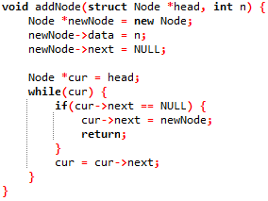
Insertion algorithm vs c++ implementation
InsertAtEnd(Node head, x)
1. Create newNode
2. newNode.data <- x
3. cur <- head
4. while cur != Null
5. do
6. if cur.next = Null
7. cur.next <- newNode
8. return
9. cur ← cur.next

Slide 21
Basic operations – insertion at the end of the list
Head
56
12
70
8
Head
56
12
70
8
5
Head
56
12
70
8
5
Head
56
12
70
8
5

Slide 22
Basic operations – insertion at the middle of the list
5
Head
56
12
70
8
5
Head
56
12
70
8
5
Head
56
12
70
8
5
Head
56
12
70
8

Slide 23
Basic operations – deletion at the beginning of the list
Head
56
12
70
8
Head
56
12
70
8
Head
56
12
70
8
Head
12
70
8

Slide 24
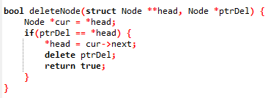
Basic operations – deletion at the beginning of the list

Slide 25
Basic operations – deletion at the middle of the list
Head
56
12
70
8
Head
56
12
70
8
Head
56
12
70
8
Head
56
70
8

Slide 26
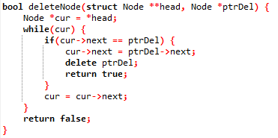
Basic operations – deletion at the middle of the list

Slide 27
Basic operations – deletion at the end of the list
Head
56
12
70
8
Head
56
12
70
8
Head
56
12
70
8
Head
56
12
70

Slide 28
Search operation in linked list
struct Node *searchNode(struct Node *head, int n) {
Node *cur = head;
while(cur) {
if(cur->data == n) return cur;
cur = cur->next;
}
return null;
}
SEARCH-LIST(head, key)
1 cur ← head
2 while cur != Null
do if cur.data = key
4 return cur
cur ← cur.next
Return null

Slide 29
Advantages of linked list over array
Advantages
1) Dynamic size
2) Ease of insertion/deletion
Drawbacks:
1) Random access is not allowed. We have to access elements sequentially starting from the first node.
2) Extra memory space for a pointer is required with each element of the list.
3) Not cache friendly. Since array elements are contiguous locations, there is locality of reference which is not there in case of linked lists.

Slide 30
Comparison of Sequential and Linked Organizations
Sequential organization The features of this organization are the following:
Successive elements of a list are stored a fixed distance apart.
It provides static allocation, which means, the space allocation done by a compiler once cannot be changed during execution, and the size has to be known in advance.
As individual objects are stored a fixed distance apart, we can access any element randomly.
Insertion and deletion of objects in between the list require a lot of data movement.
It is space inefficient for large objects with frequent insertions and deletions.
An element need not know/store and keep the address of its successive element.

Slide 31
Comparison of Sequential and Linked Organizations
Linked organization The features of this organization include the following:
Elements can be placed anywhere in the memory.
Dynamic allocation (size need not be known in advance), that is, space allocation as per need can be done during execution.
As objects are not placed in consecutive locations at a fixed distance apart, random access to elements is not possible.
Insertion and deletion of objects do not require any data shifting.
It is space efficient for large objects with frequent insertions and deletions.
Each element in general is a collection of data and a link. At least one link field is a must.
Every element keeps the address of its successor element in a link field.
The only burden is that we need additional space for the link field for each element. However, additional space is not a severe penalty when large objects are to be stored.
Linked organization needs the use of pointers and dynamic memory allocation.

Slide 32
Quiz 1
Write an algorithm for program that returns the number of the nodes in the linked list?

Slide 33
Quiz 1
Write an algorithm for program that update the a value of a node in a linked list?
Note: the node can be located anywhere in the linked list.

